Slide 1
Sensing Language Relationships from Social Media
Diogo Pacheco¹, Priya Saha¹, Fernando B. Lima-Neto²,
Ronaldo Menezes¹
¹ Florida Institute of Technology
² University of Pernambuco

Slide 2
Motivation
What can we learn about languages from users online usage?
Is there any difference from a language spoken in different regions? For instance, the French speakers on Canada to the ones in France?
Language similarity or geographical proximity? Is my second language the easiest one to learn?
Can we use social media to sense languages and detect cultural shifts?
Applications: marketing, linguistics, etc.

Slide 3
Datasets

Slide 4
Twitter Datasets
GLOBAL
COUNTRY
CITY
Notes:
Descriptive statistics of 12 datasets identified by their locality level, global ($\diamond$), country($\dagger$), and city($\star$); the number of tweets and users; the total number of languages $|L|$ and languages used by at least 10 users $|L|^+$; the percentage of monolingual users; the average number of languages used by multilingual users; and the collection period.

Slide 5
Comparing Datasets of Distinct Locality Levels
Notes:
Datasets validation. Comparing the correlations between pairs of datasets at different levels of locality: global (Olympics16), countries (The United Kingdom), and city (Tokyo). The correlations are higher for the pairs with the global dataset than for the pairs with the city one. The top row shows the correlation between the number of users tweeting in a language, i.e. each point is a specific language; while the bottom row shows the correlation of users with tweets in pairs of languages, e.g. the number of users using English and Japanese. Comparison between datasets: Olympics16 and The United Kingdom (I and IV); Olympics16 and Tokyo (II and V); and The United Kingdom and Tokyo (III and VI).

Slide 6
Locality Effect
Notes:
Datasets validation. Measuring the locality effect of datasets on language relationships. Each boxplot contains the Pearson correlations for 11 pairs of datasets. From Hong Kong (top) to Olympics16 (bottom), datasets vary from more local to more global level as depicted by the following special marks: city-level ($^\star$), country-level ($^\dagger$), and global-level ($^\diamond$). On average, global datasets presents higher correlation than city datasets. On the left, correlations between users tweeting in one language, while on the right, the correlations of users tweeting in pairs of language. The top blocks show individual dataset comparisons while bottom blocks show inter and intra-levels comparisons.

Slide 7
Characterizing Users

Slide 8
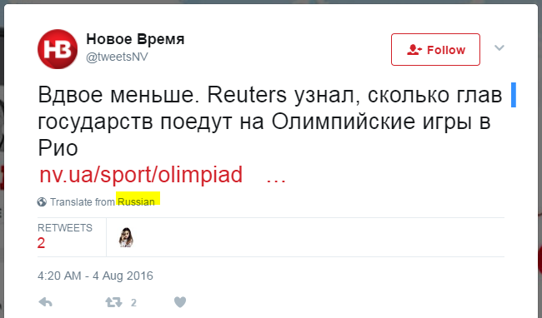
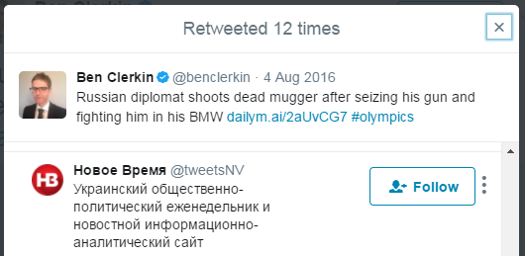
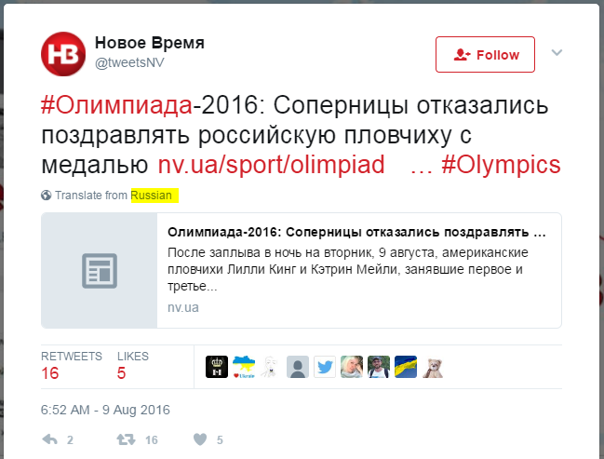
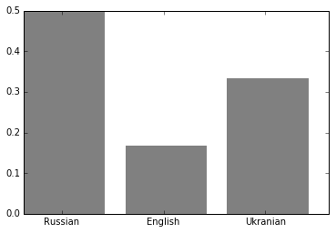
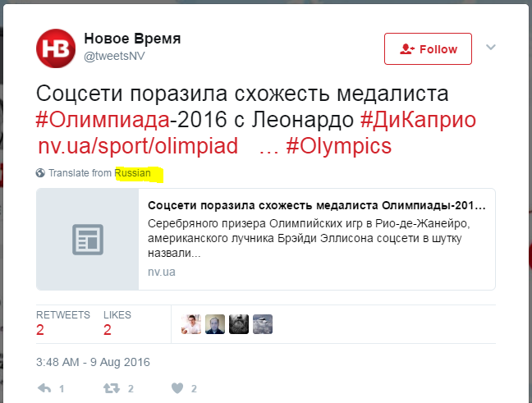
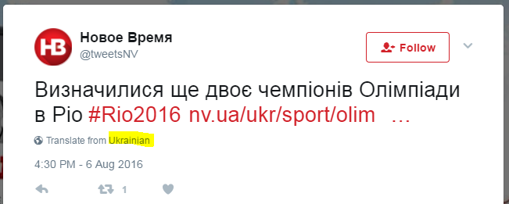
Characterizing Users

Slide 9
Language Characterizations

Slide 10
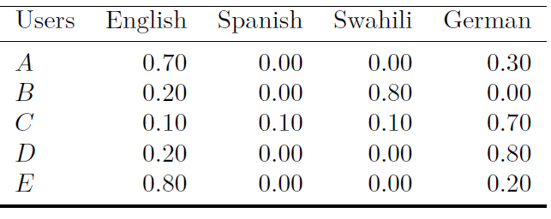
Toy Example

Slide 11
Ordered Language Characterizations

Slide 12
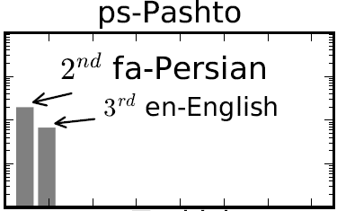
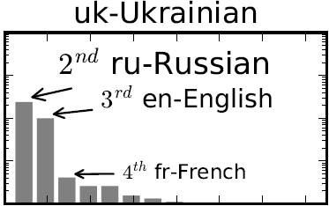
Few Exceptions for English as 2nd Language

Slide 13
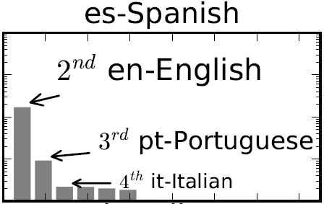
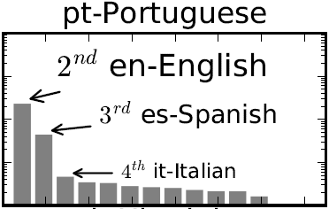
Strong Reciprocity

Slide 14
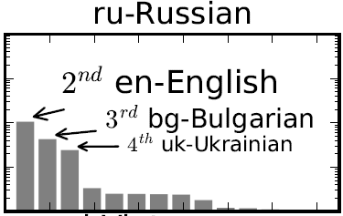
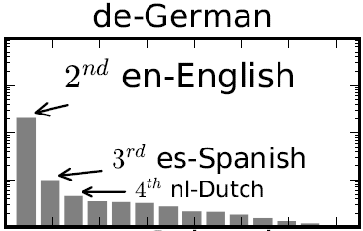
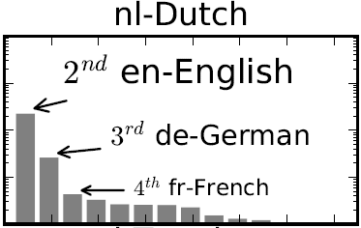
Lack of Reciprocity

Slide 15
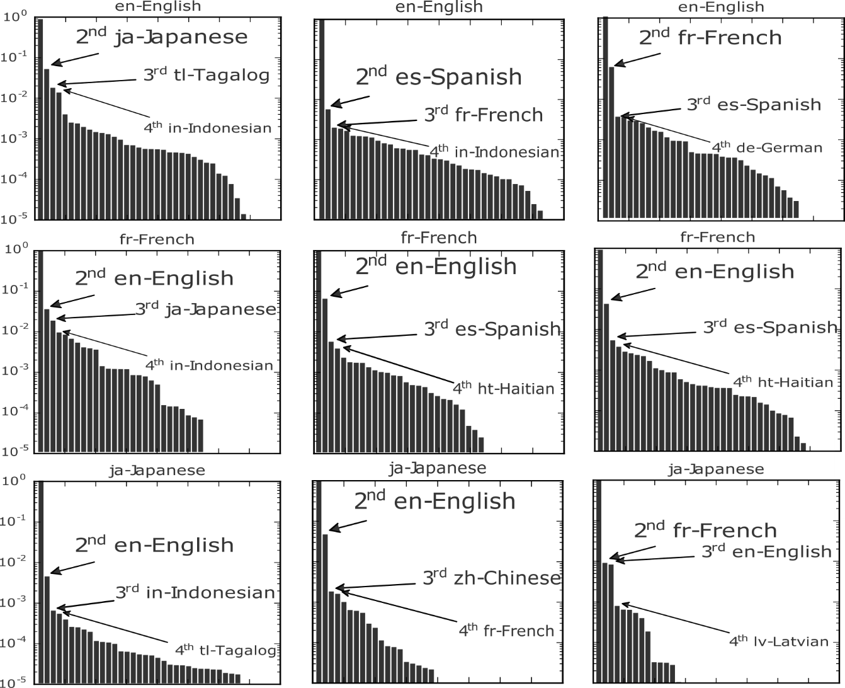
Locality Effect
Tokyo
NYC
Paris
Notes:
In this figure, columns are the city-level datasets: Tokyo, NYC, and Paris. While the rows contain the characterization of English, French, and Japanese in these datasets.
By looking at different city-level dataset we can see how locality affects the language characterizations. For instance, English speakers are very different in NYC, Tokyo, and Paris; their second language is Spanish, Japanese, and French, respectivelly.

Slide 16
Language Network

Slide 17
Toy Example
English
0.20
0.25
0.15
Swahili
0.05
German
0.05
Spanish

Slide 18
The Language Network

Slide 19
Spatial Correlation from the Network
80% Arabic, 20% French
59% English, 22% French

Slide 20
Language Clusters

Slide 22
Spatial Correlation from Clusters

Slide 23
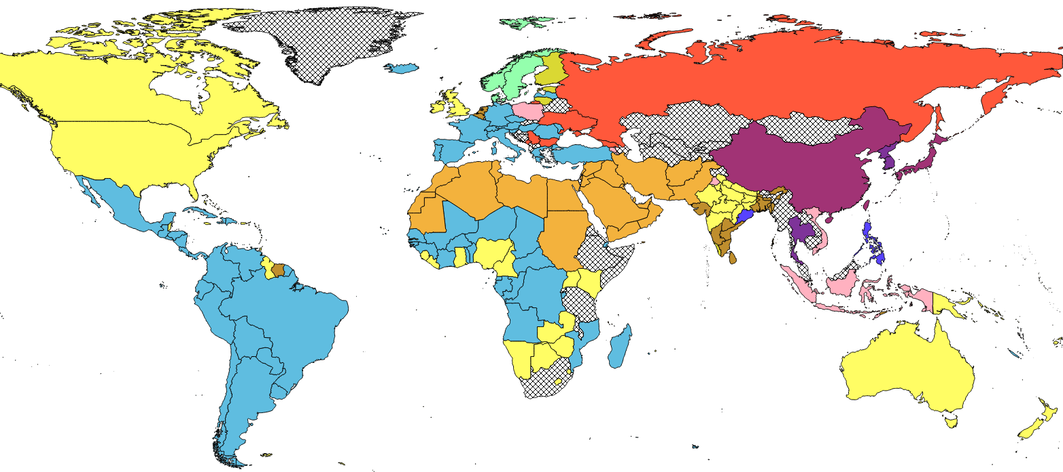
11 communities
15 clusters

Slide 24
Conclusions
What can we learn about languages from users online usage?
Several things. We can explore the language relashionships at different granularities, i.e. we can focus on individual a language (language characterization), or we can explore the whole structure (language network), or we can tune in between (hierarquical clusters).
Is there any difference from a language spoken in different regions? For instance, the French speakers on Canada to the ones in France?
Yes! Languages are very distinct from place to place. Be careful while choosing your dataset, to conscious conclude locally or globally.
Language similarity or geographical proximity? My second language is the easiest one to learn?
No. Geographical proximity plays a significant role in the way people communicate.
Can we use social media to sense languages and detect cultural shifts?
Looks promissing. To be continued...

Slide 25
Limitations
Bias of Twitter data
Accuracy of the Twitter language detector
Lack of longitudinal data to verify the variability of language characterizations over time or during special events (e.g. Olympics)

Slide 26
Sensing Language Relationships from Social Media
Questions?
dpacheco@biocomplexlab.org
Diogo Pacheco¹, Priya Saha¹, Fernando B. Lima-Neto²,
Ronaldo Menezes¹
¹ Florida Institute of Technology
² University of Pernambuco

Slide 27
Extra Slides

Slide 28
Twitter Datasets
Notes:
Descriptive statistics of 12 datasets identified by their locality level, global ($\diamond$), country($\dagger$), and city($\star$); the number of tweets and users; the total number of languages $|L|$ and languages used by at least 10 users $|L|^+$; the percentage of monolingual users; the average number of languages used by multilingual users; and the collection period.

Slide 29
Datasets Collection Process
2016 Olympic Games - It refers to the 2016 Summer Olympic Games hosted in Brazil with more than 11,000 athletes from 207 countries. We tracked the 107 languages available in Google Translator, by October 2016, using the translations for the word "olympics"; since some languages present the same spelling, the dataset is formed based on the set of the 64 different spelling forms.
G-20 - We tracked the last name of the leaders of the Group of Twenty (G-20) in 2014: Zuma, Kirchner, Roussef, Pena Nieto, Harper, Obama, Jinping, Noda, Myung-bak, Singh, Yudhoyono, Abdullah, Erdogan, Merkel, Hollande, Renzi, Putin, Cameron, and Gillard.
2015 Womens' World Cup & America Cup - It refers to these two co-occurring football competitions in 2015, the former hosted in Canada and the later hosted in Chile. We tracked the 3-letter hashflags and Twitter official accounts from the 31 competing national squads. Brazil, USA, China, Nigeria, Ecuador, Canada, Thailand, France, England, Cameroon, Côte d'Ivoire, Switzerland, Spain, Colombia, Costa Rica, Sweden, Norway, Mexico, Australia, Japan, Korea, New Zealand, Germany, Argentina, Bolivia, Chile, Jamaica, Paraguay, Peru, Uruguay, and Venezuela.
2014 FIFA World Cup - It refers to the most popular sport event in the world, hosted in Brazil. We tracked the 32 nation squads' 3-letter hashflags. Algeria, Cameroon, Côte d'Ivoire, Ghana, Nigeria, Australia, Iran, Japan, Korea Republic, Belgium, Bosnia and Herzegovina, Croatia, England, France, Germany, Greece, Italy, Netherlands, Portugal, Russia, Spain, Switzerland, Costa Rica, Honduras, Mexico, USA, Argentina, Brazil, Chile, Colombia, Ecuador, and Uruguay.
2016 UEFA Euro - It refers to the football event hosted in France. We tracked the 32 nation squads' 3-letter hashflags. Albania, Austria, Belgium, Croatia, Czech Republic, England, France, Germany, Hungary, Iceland, Italy, Northern Ireland, Poland, Portugal, Republic of Ireland, Romania, Russia, Slovakia, Spain, Sweden, Switzerland, Turkey, Ukraine, and Wales.
The United Kingdom - These are tweets collected using the bounding box of the United Kingdom, which encompasses four countries: England, Scotland, Wales, and Northern Ireland.
South America - These are tweets collected using a bounding box of Brazil, which encompasses most areas and countries of South America, except Ecuador.
New York City, Paris, San Francisco, Tokyo, and Hong Kong - These are geo-tagged tweets within the bounding box of the city.

Slide 30
“Olympics” Translations

Slide 31
Network Centralities
Notes:
Top eight languages ranked in the LN based on in/out degree and weighted degree, and eigenvector centralities.

